Slide 1
Team GSU Sentinels
Home depot code Athlon

Slide 2
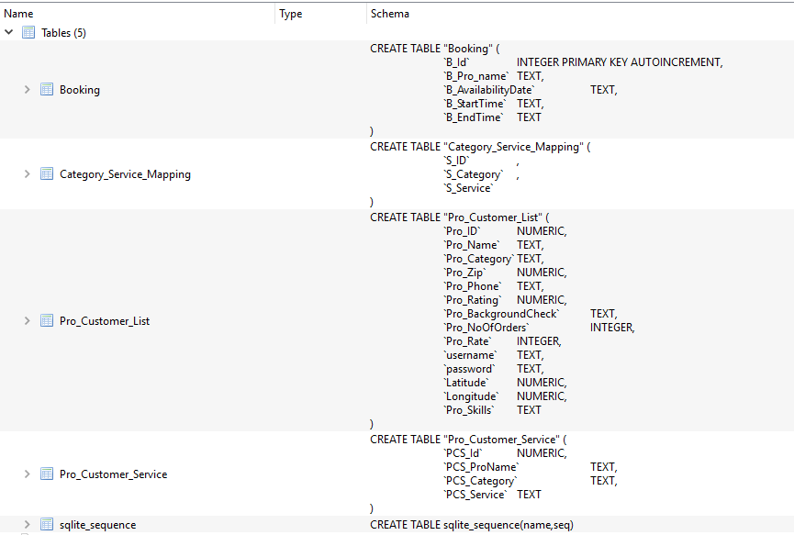

Slide 3
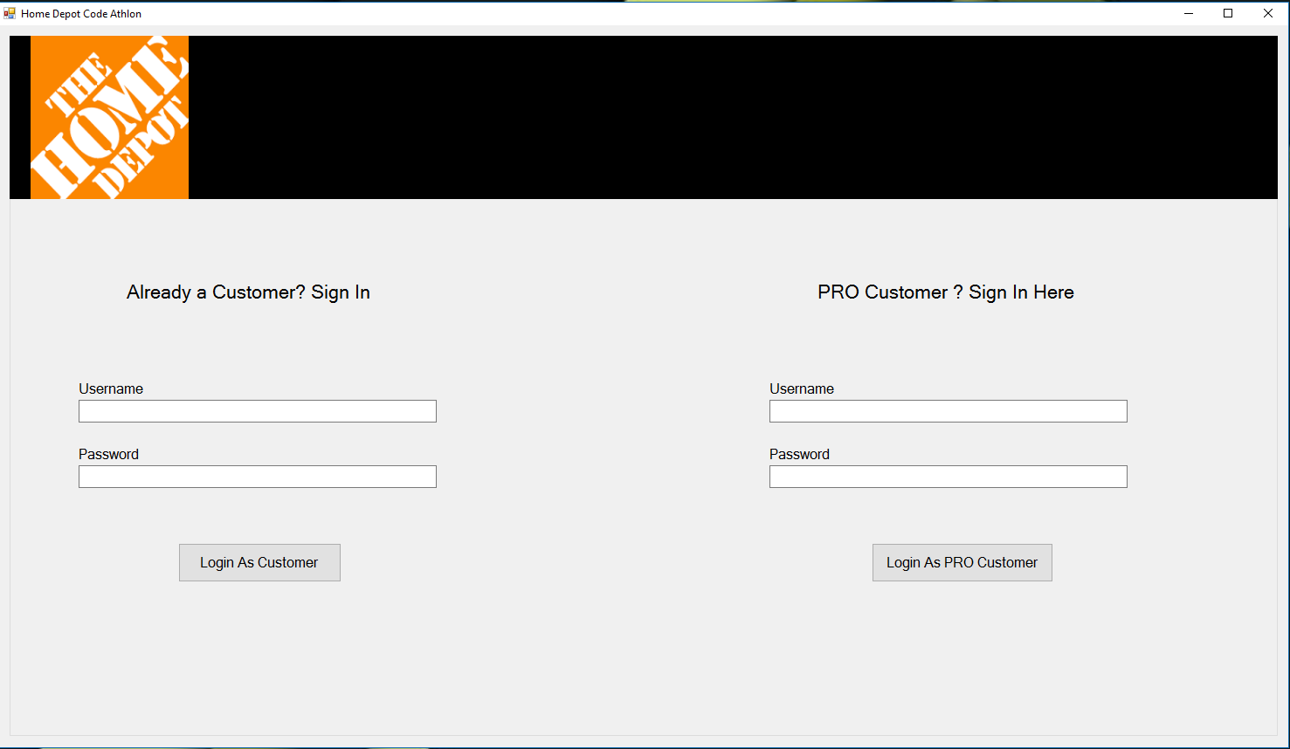

Slide 4
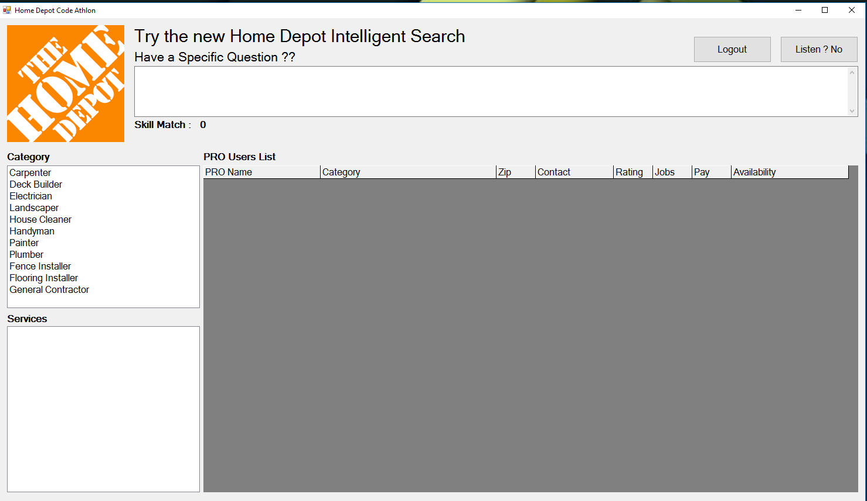

Slide 5
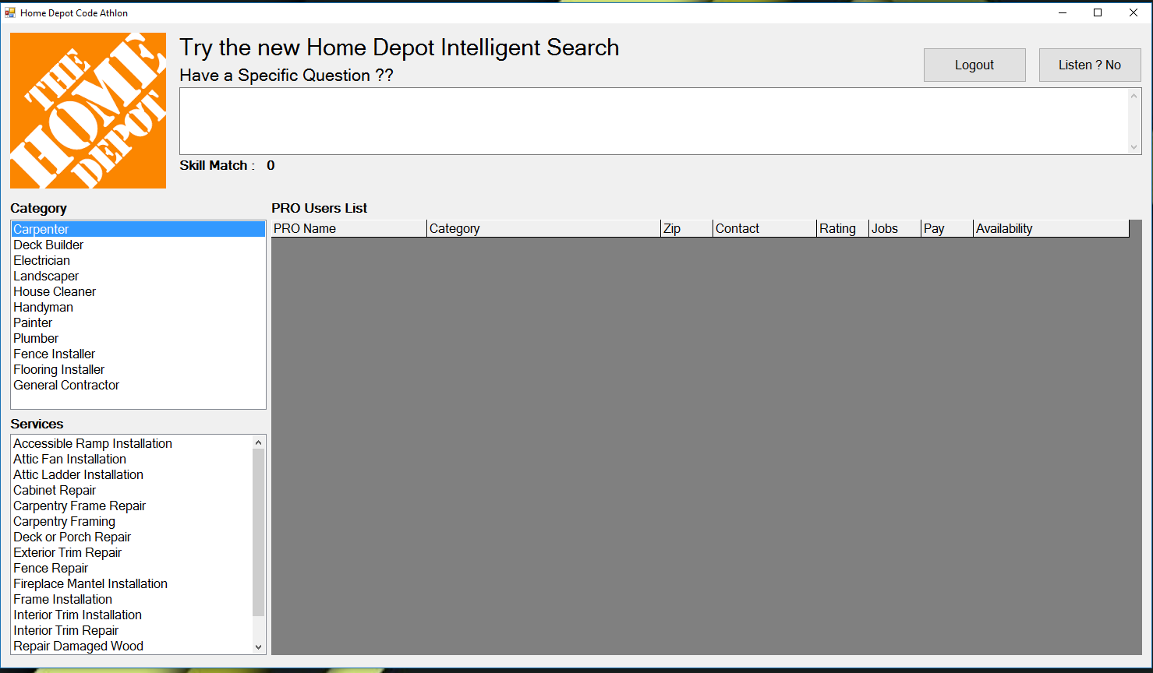

Slide 6
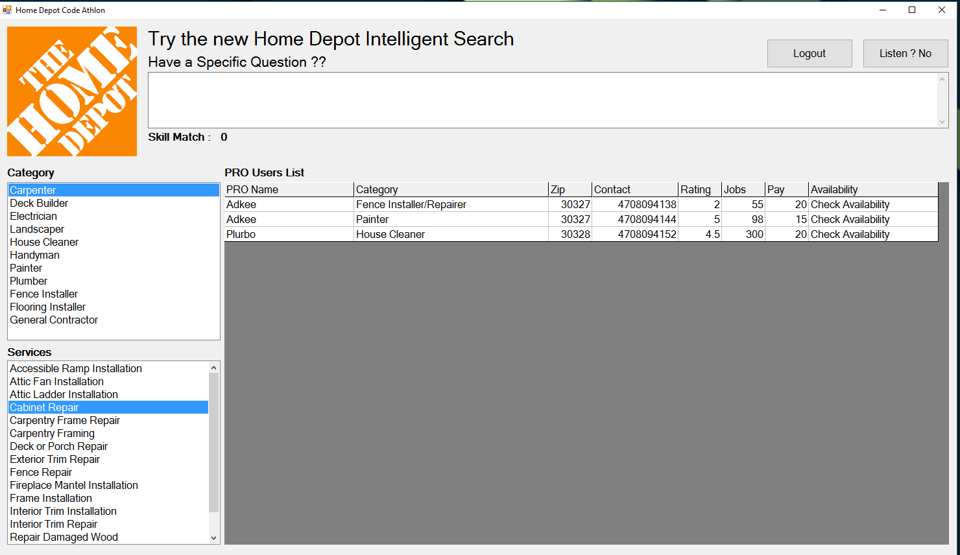

Slide 7
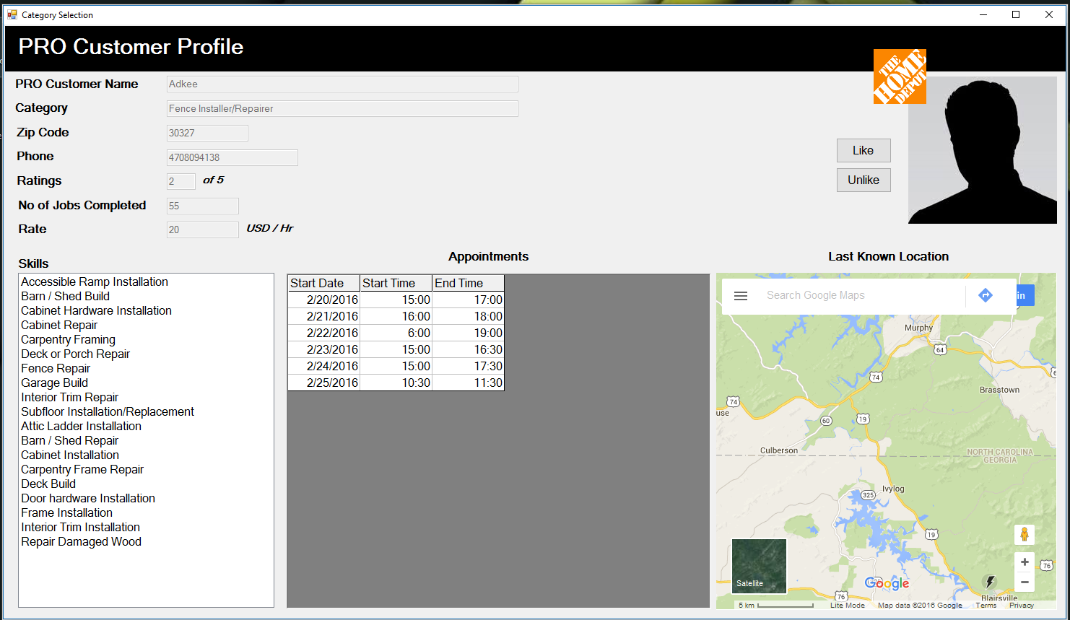

Slide 8
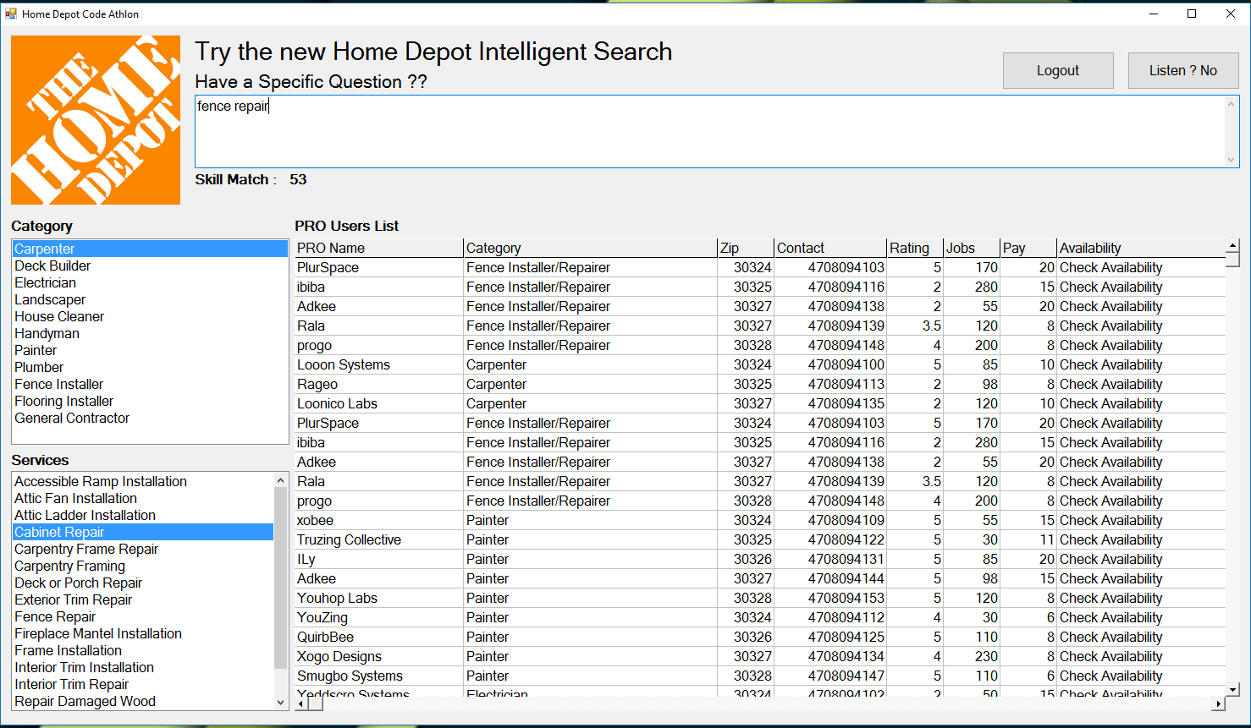

Slide 9
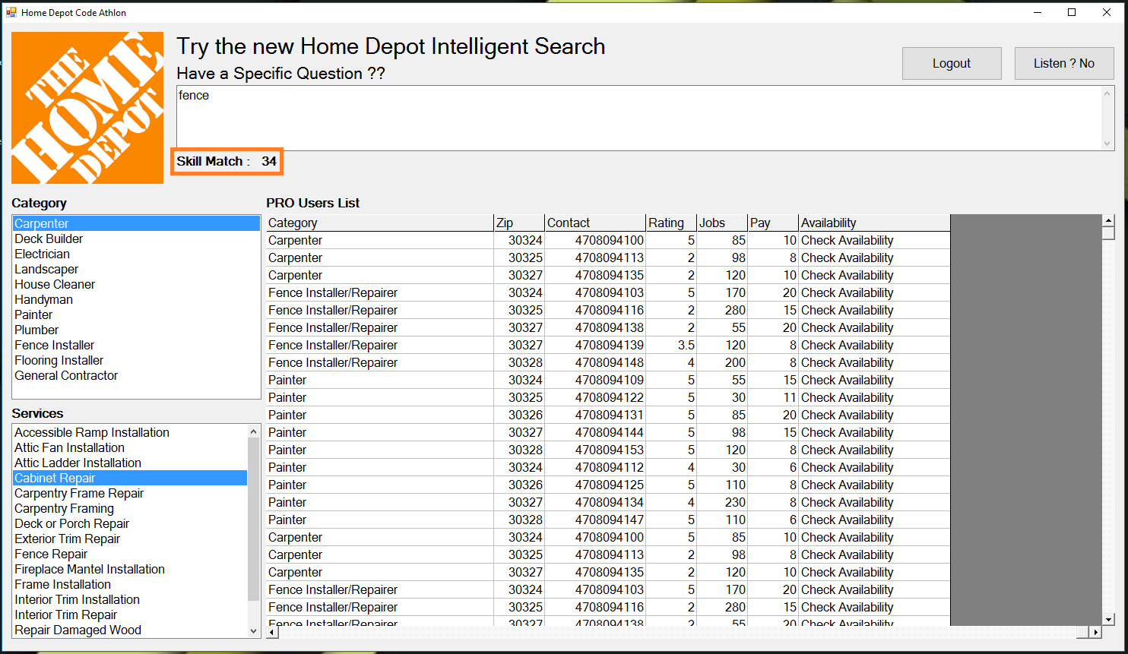

Slide 10
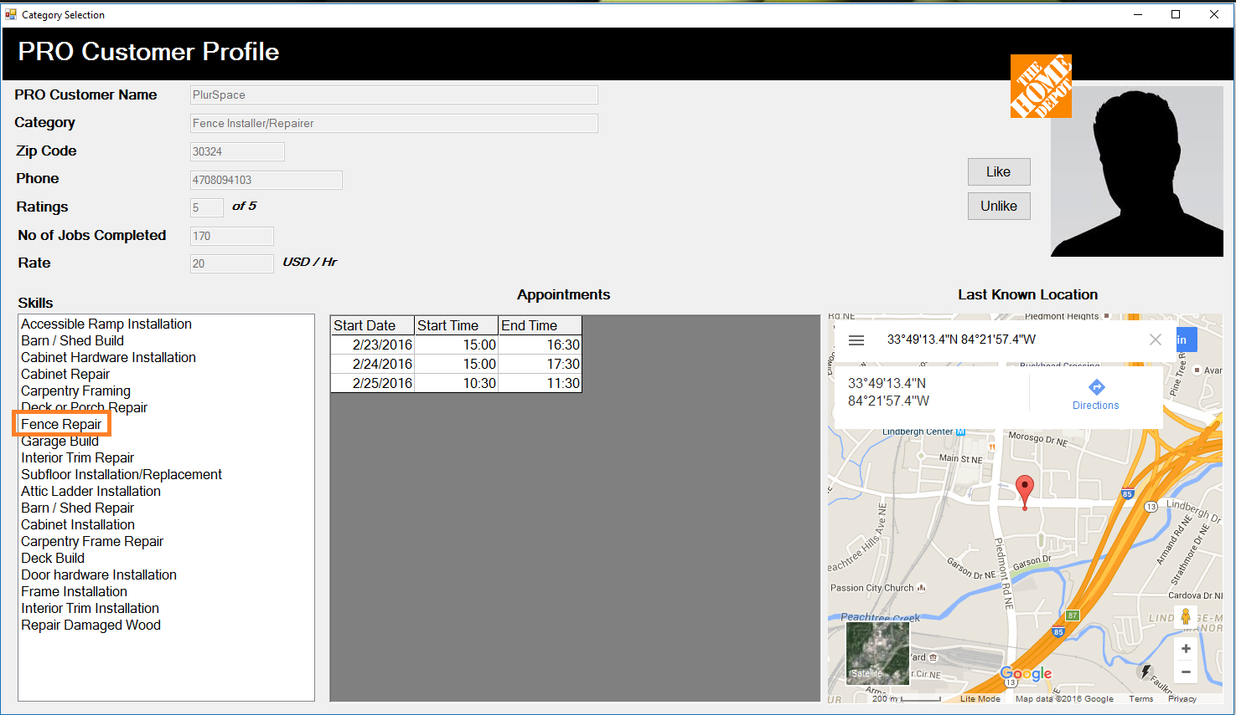

Slide 11
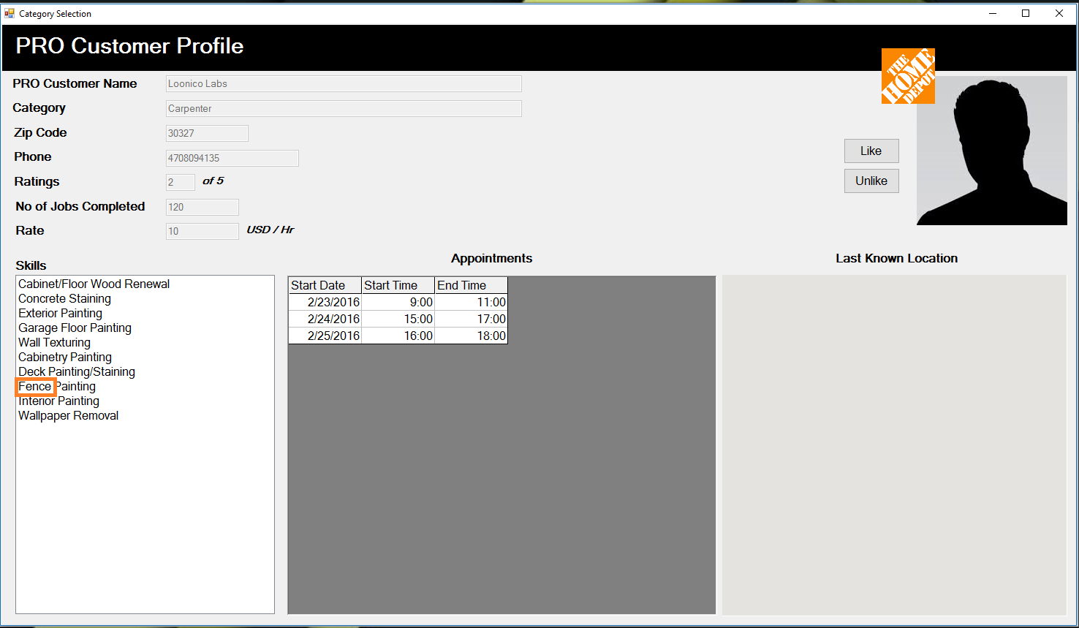

Slide 12
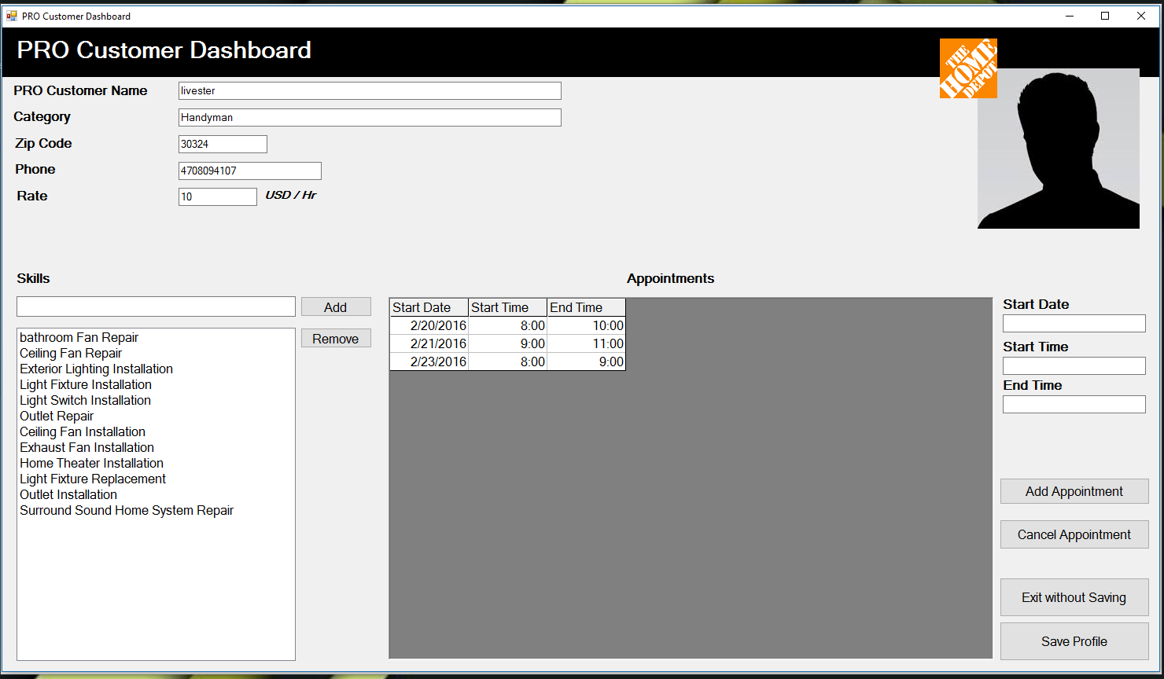

Slide 13
Tools and Tech. Used
Transactional Database – SQLite
Data Warehouse – Apache Hive
App Development – C# .NET
Data Store – Apache Hadoop HDFS
Business and Behavior Analytics – Tableau on Apache Spark
Clusters – Microsoft HDInsight Hadoop-On-Cloud Solution

Slide 14
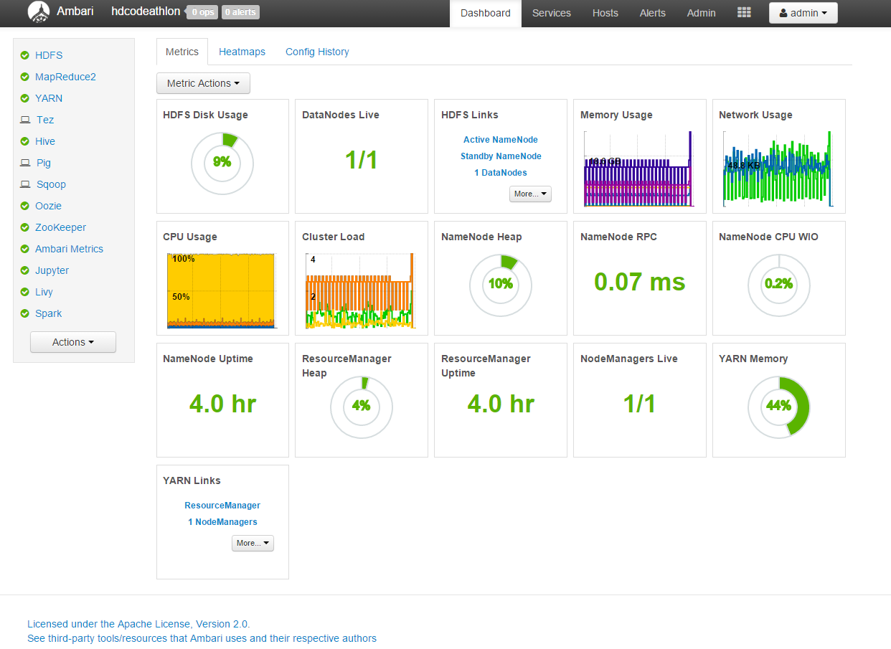

Slide 15
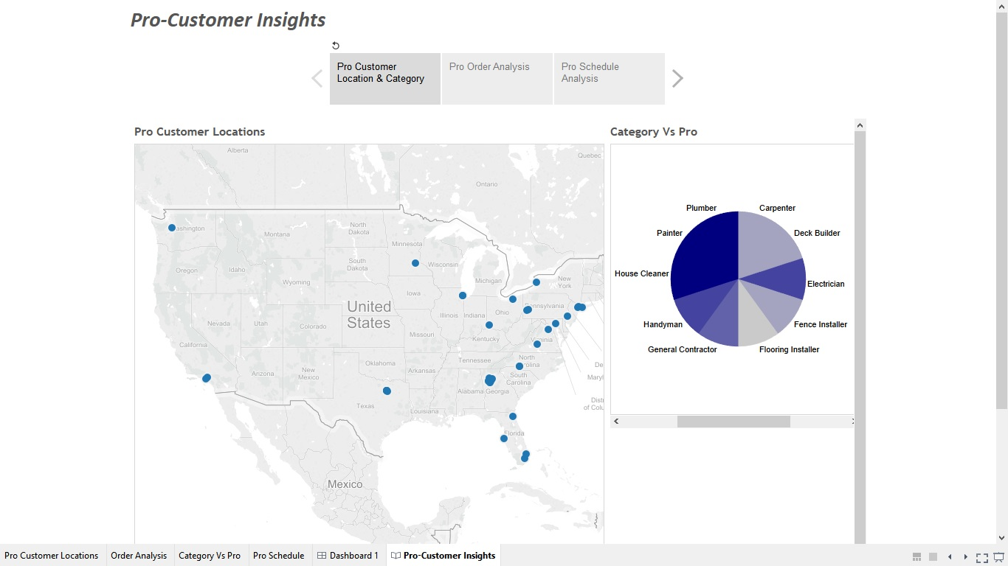

Slide 16
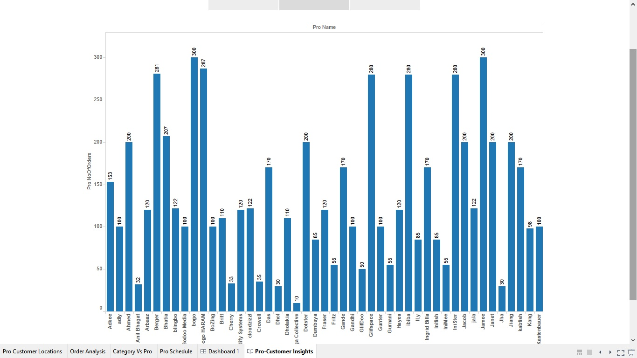

Slide 17
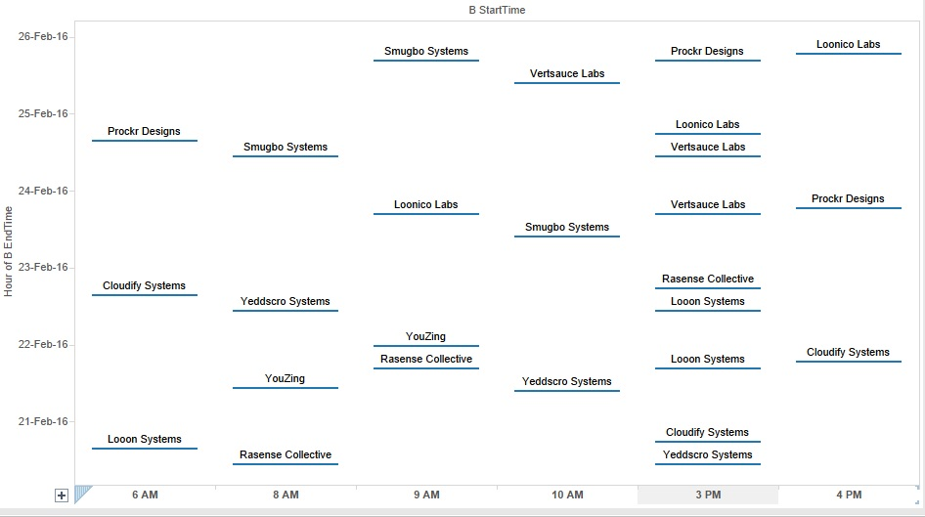

Slide 18
Stuff we wanted to implement!! But Couldn’t
Speech Recognition for interactive querying.
DIY Tutorials Videos.
Adaptive Page ranking algorithm based on insights obtained from data.

Slide 19
That’s all folks!!
Questions??

